Slide 1
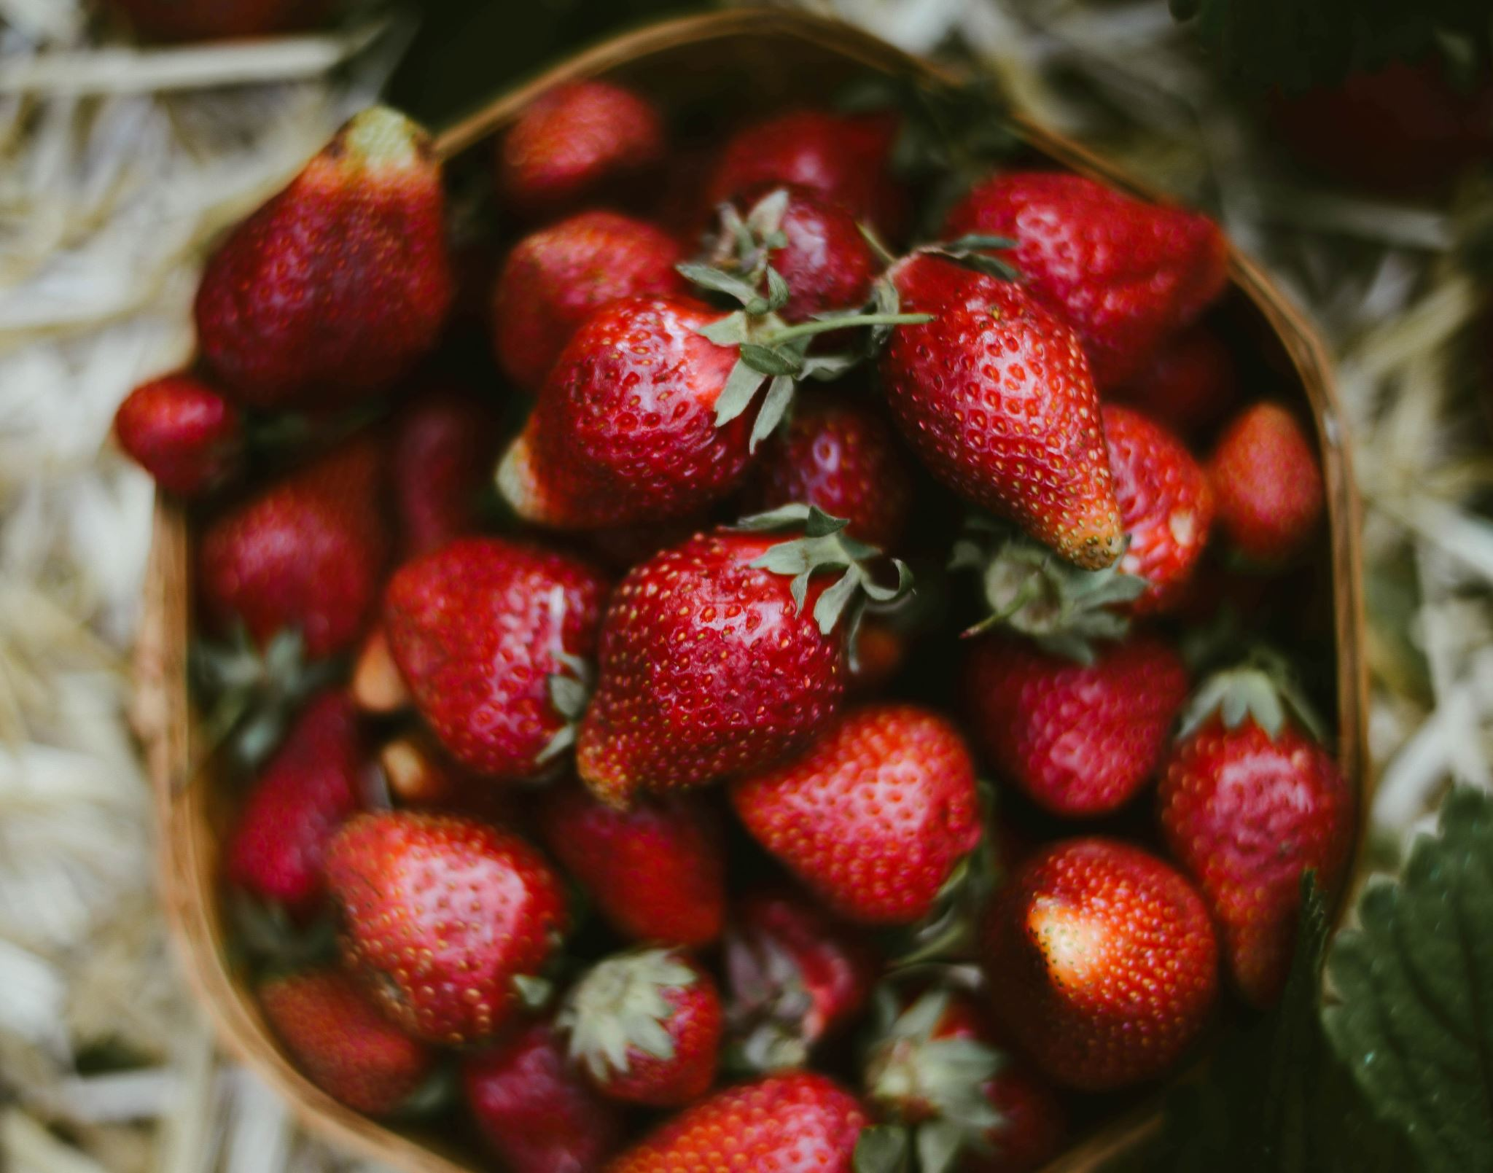
Impact of Mulch on Strawberry Production
"A Statistical Comparison of Yield Performance"
Kevin Fantinatti – MS Student Ag. Sciences
University of New Hampshire

Slide 2
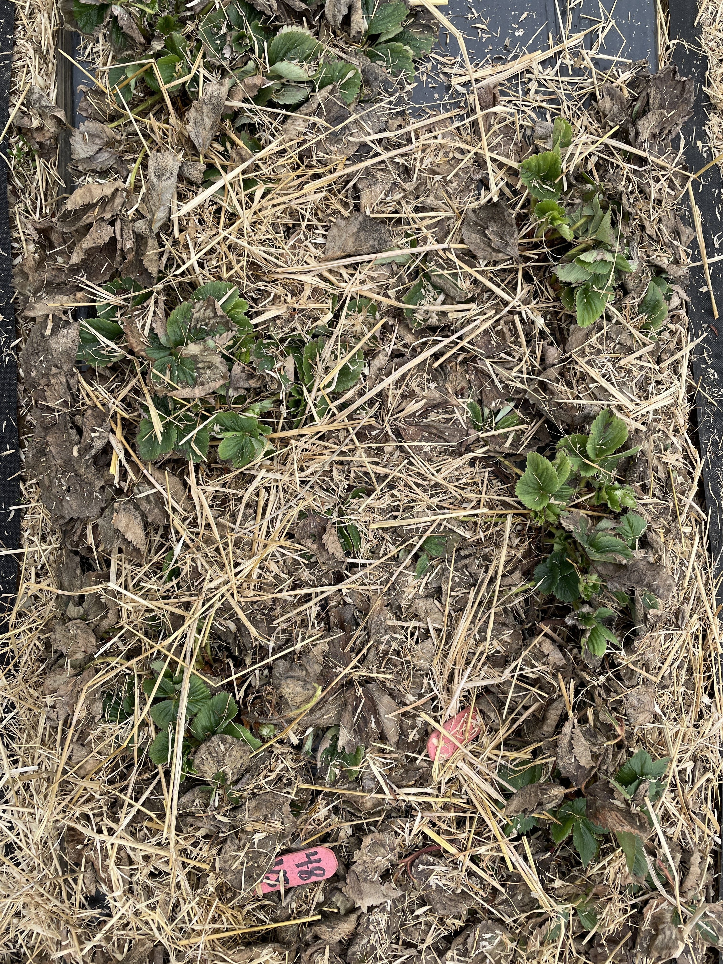
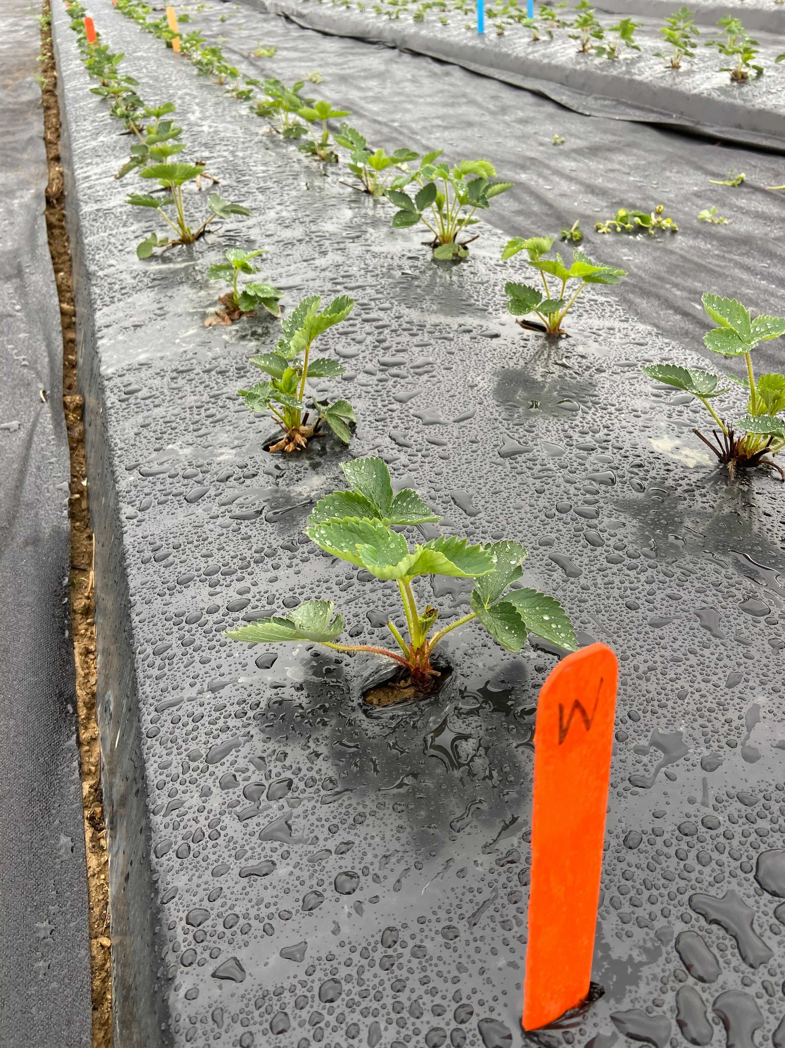
Overview
Three Varieties: Wendy (W), Allstar (A), Valley Sunset (VS)
Treatments: Straw Mulch x Plastic Mulch
Objective: Evaluate the effects of straw mulch on three strawberry varieties crop yield.
Hypothesis: "Strawberry varieties under straw mulch treatment will produce better results than plastic treatment."
Straw Mulch
Plastic Mulch
Notes:
Because the plants can root runners into the soil without being obstructed by black plastic. We believe this natural rooting process will enhance the overall growth and yield of the plants.

Slide 3
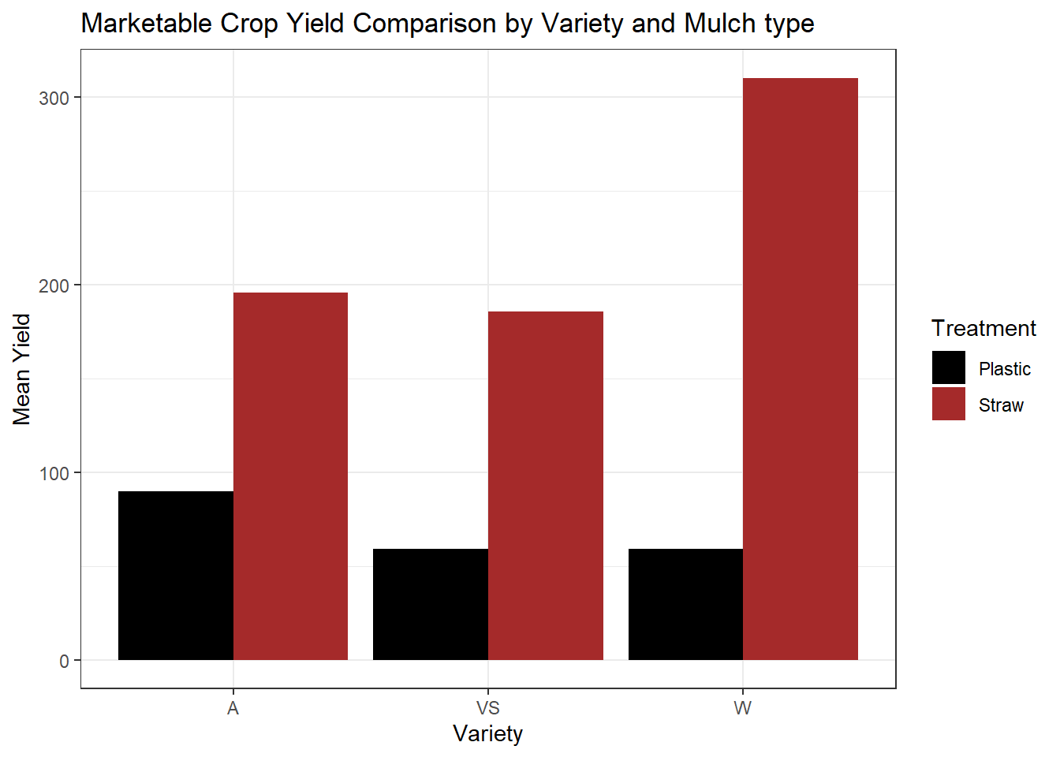
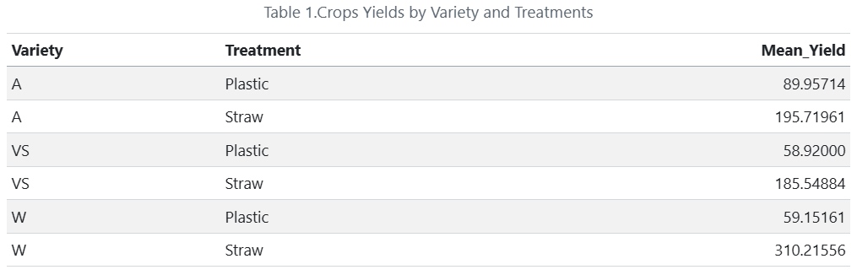
Data Analysis
All strawberry varieties perfomed better on Straw Mulch treatment.

Slide 4
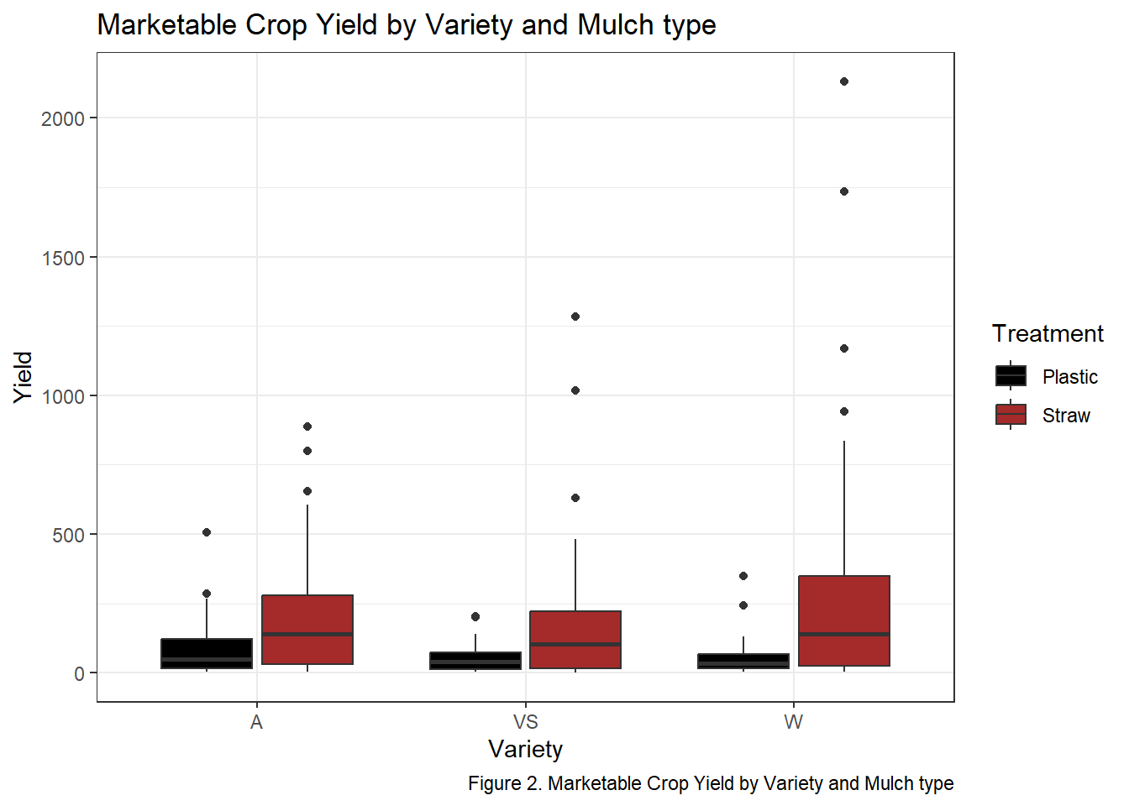
Data Analysis
All strawberry varieties perfomed better on Straw Mulch treatment.
Yield Increase:
Allstar (A) = 117.57%
Valley Sunset (VS) = 214.92%
Wendy (W) = 424.44%

Slide 5
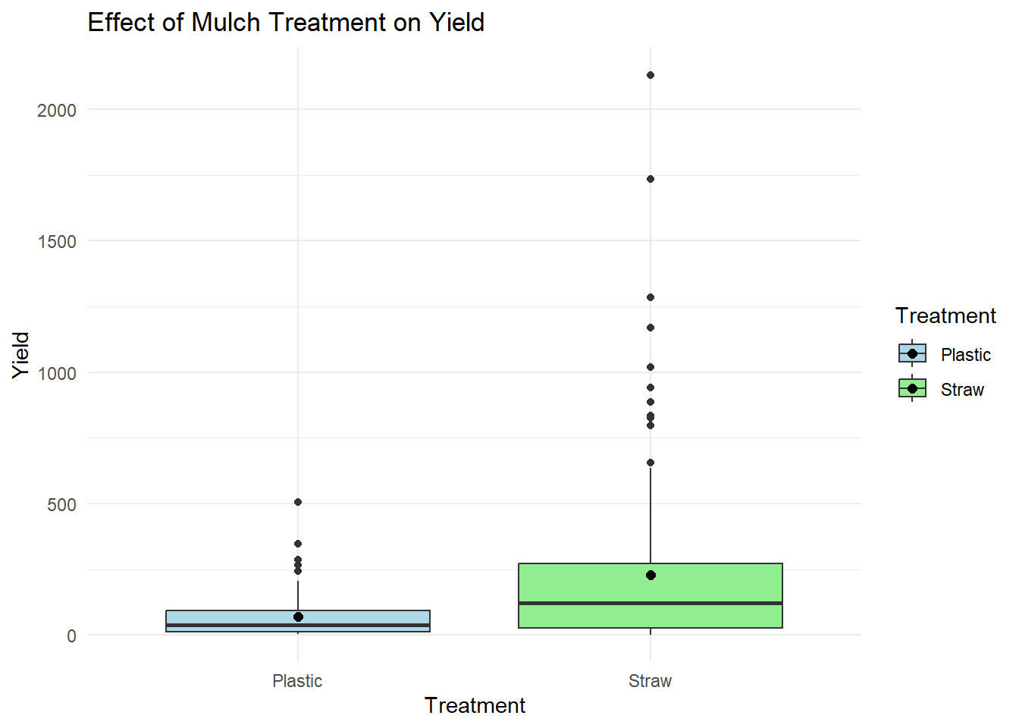
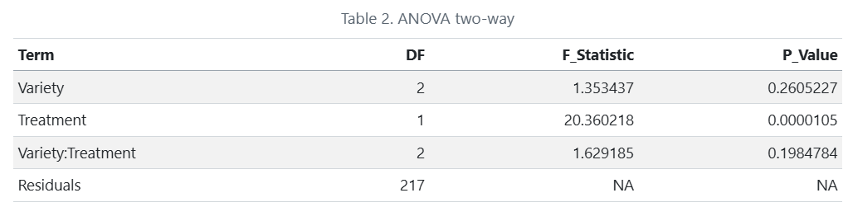
Statistical Analysis
Two-way ANOVA with interactions: Yield ~ Variety * Treatment
Main effects:
Treatment: Significant (p < 0.001)
Variety: Not significant (p = 0.26)
Interaction Variety-Treatment: Not significant (p = 0.19)

Slide 6
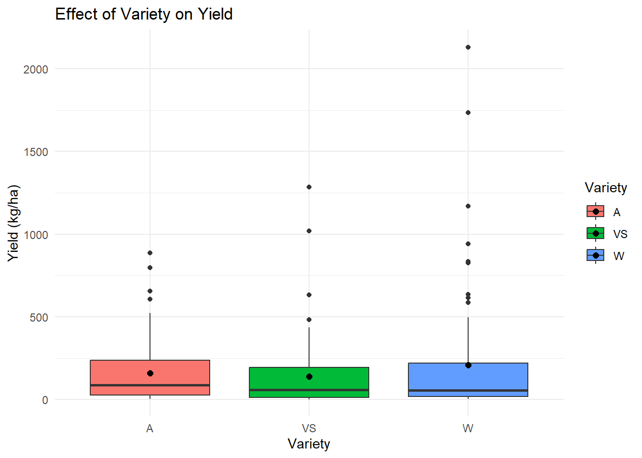
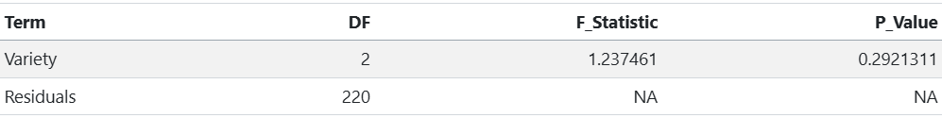
Statistical Analysis
Two-way ANOVA with interactions: Yield ~ Variety
Main effects:
Variety: Not significant (p = 0.29)
Varieties perfoms similar under same conditions.

Slide 7
Conclusion
Hypothesis: Confirmed
"All strawberry varieties performed better under Straw Mulch treatment."
Transitioning from plastic to straw mulch are promising strategy for the NE strawberry growers.
Enhacing production
Reducing plastics

Slide 8
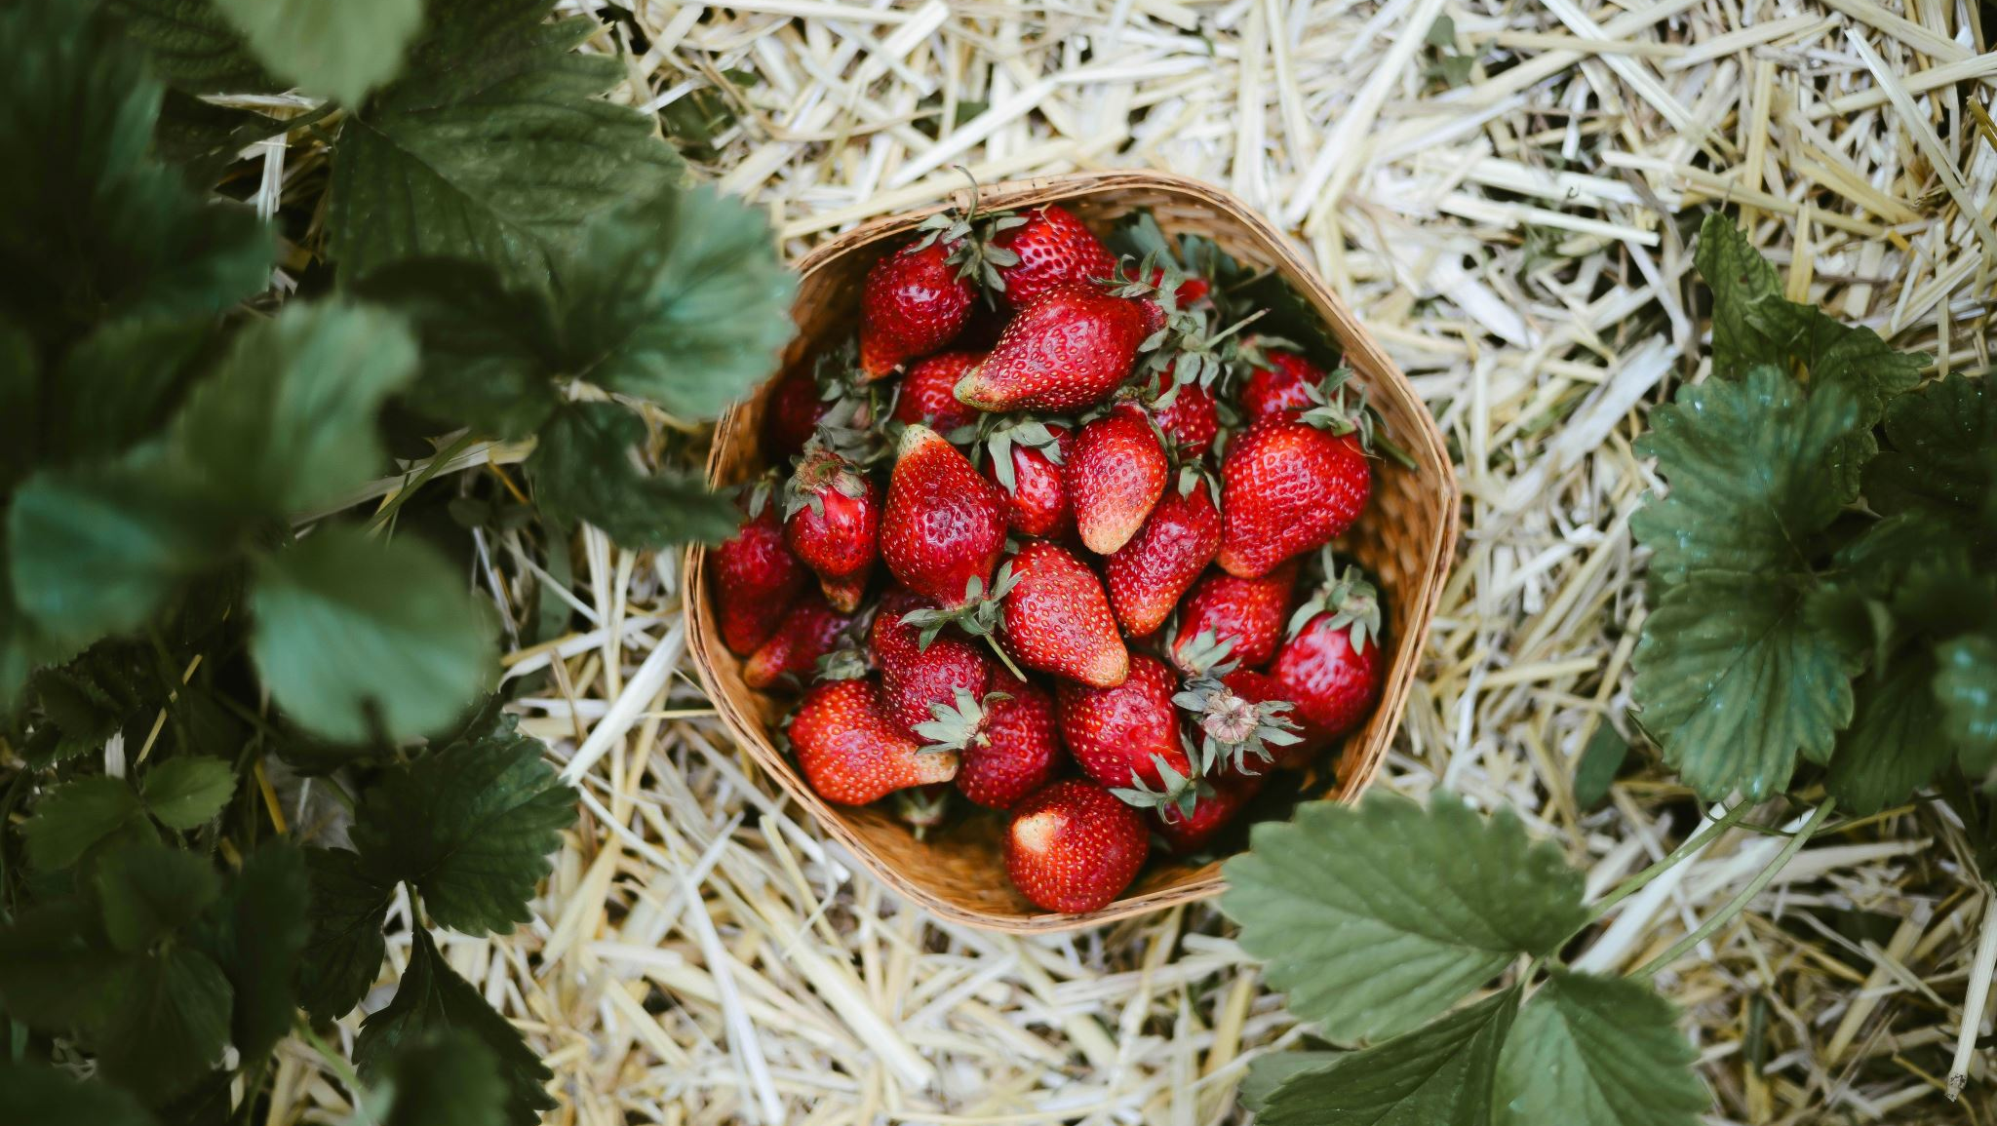
Thank you all!

